Slide 1
B2B2C E-COMMERCE PLATFORM
COS20031-G05 Computing Technology Design Project
Tran Thai Duy Khang - 104225629
Trinh Quy Khang - 104212003
Le Huu Tuong - 104169756
Nguyen Quoc Thang - 104193360
Nguyen Do Nhat Nam - 104061616
Tran Thanh Minh - 103809048
Thanh Minh
Notes:
Welcome to Group 5 of Unit COS20031 - Computing Technology Design Project. Our team include 6 members: Tran Thai Duy Khang, Trinh Quy Khang, Le Huu Tuong, Nguyen Quoc Thang, Nguyen Do Nhat Nam, Tran Thanh Minh. Our topic that we choose for this topic is designing B2B2C E-commerce platform database which contains a lot of categories.

Slide 2
01
02
03
Introduction
Project Background
Project Requirements
Huu Tuong
Notes:
Our team is focused on designing and building a database infrastructure to store RFPs for B2B2C e-commerce systems. We are undertaking this project to create a robust platform aimed at connecting businesses with consumers, increasing efficiency, and productivity in the exchange of buying and selling products and services offered by various enterprises.

Slide 3
Mission Statement & Objectives
Mission Statement
Objectives
Huu Tuong
Enhance Business Connectivity.
Elevating User Experience.
Driving Innovation and Scalability
Ensuring Security and Trust
Delivering Reliable Support and Partnership
Strengthen B2B relationships for seamless collaboration.
Design an intuitive interface for a user-friendly journey.
Foster a culture of innovation for continuous improvement.
Implement robust cybersecurity for user confidence.
Provide responsive support and foster strong partnerships.

Slide 4



Contribution to Solution
Tran Thanh Minh
Tran Thai Duy Khang
Trinh Quy Khang
Nguyen Quoc Thang
Update Jira tasks weekly
Assigning tasks
Initial ERD
Risk Assessment
Team agreement
Persona
MySQL Create Table Statement
Performance (Indexes in database)
Dummy Data Creation
Create Jira Tasks
Team Homepage
Empathy Map
Roles and responsibilities
Dummy data
Create Jira Tasks
Team Homepage
Empathy Map
Roles and responsibilities
Dummy data
Notes:
Hello everyone, today I will share with you the roles and responsibilities of team members.
Each team member has their own role and responsibility, contributing to the team's success.
Tran Thai Duy Khang and Trinh Quy Khang both have roles in creating Jira tasks, team homepages, empathy maps, task assignments, and dummy data..
Minh is the member in charge of tasks such as updating Jira tasks weekly, assigning tasks, creating initial ERD diagrams, risk assessments, team agreements, creating user templates, creating MySQL table creation statements and create fake data.

Slide 5
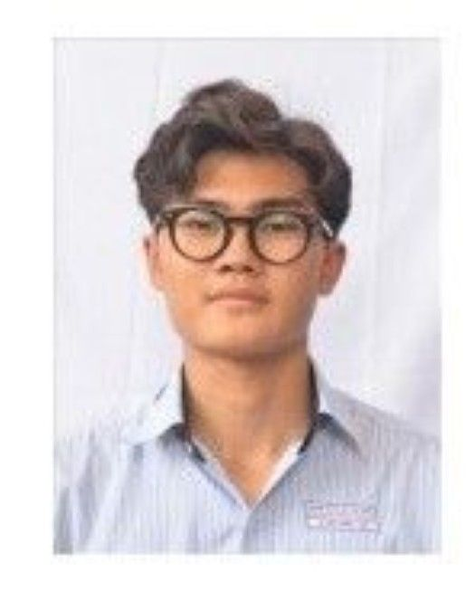


Contribution to Solution
Le Huu Tuong
Nguyen Do Nhat Nam
Nguyen Quoc Thang
Update Jira tasks weekly
Assigning tasks
Initial ERD
Risk Assessment
Team agreement
Persona
MySQL Create Table Statement
Performance (Indexes in database)
Dummy Data Creation
Meeting notes
Project Plan
Product requirements
Team Health Monitor
MySQL Transaction
MySQL Dump
4Ls Retrospective
Dummy Data Creation
Project Plan
Product requirements
Team Health Monitor
MySQL Transaction
MySQL Dump
4Ls Retrospective
Create Timeline in Jira
Dummy Data Creation
Nguyen Quoc Thang
Notes:
In the team, Nam and Thang are responsible for technical tasks, including:
Take meeting notes
Project planning
Collect product requirements
Monitor your team's health status
Implement MySQL transactions
Create a MySQL backup
Organize project summary meetings
Tuong is responsible for testing related tasks, including:
Update Jira tasks weekly: Tuong updates the status of testing tasks weekly to ensure the team stays informed of work progress.
Assigning tasks: Tuong coordinates with the team leader to assign testing tasks to team members.
Create an initial ERD diagram: Create an initial ERD diagram to clearly understand the structure of the data.
Risk assessment: Tuong evaluates project risks to provide risk control measures.
Team agreement: Tuong participates in building team agreements to ensure all team members clearly understand the working rules.
Create user prototypes: Tuong creates user prototypes to understand user needs.
Create a MySQL table creation statement: Tuong creates a MySQL table creation statement to store data.
Performance measurement (indexes in the database): Tuong measures the performance of the database to ensure the database works

Slide 6
Team Process
Roles and Responsibilities
Scrum Master
Resource Manager
Developer
Project Manager
Quality Manager
Nhat Nam
Notes:
This is our team process. We will divide into 5 roles and responsibilities Scrum Master – Thang Resource manager – Nam Deve;oper – 2Khang Project Manager – Tuong Quality manager - Minh

Slide 7
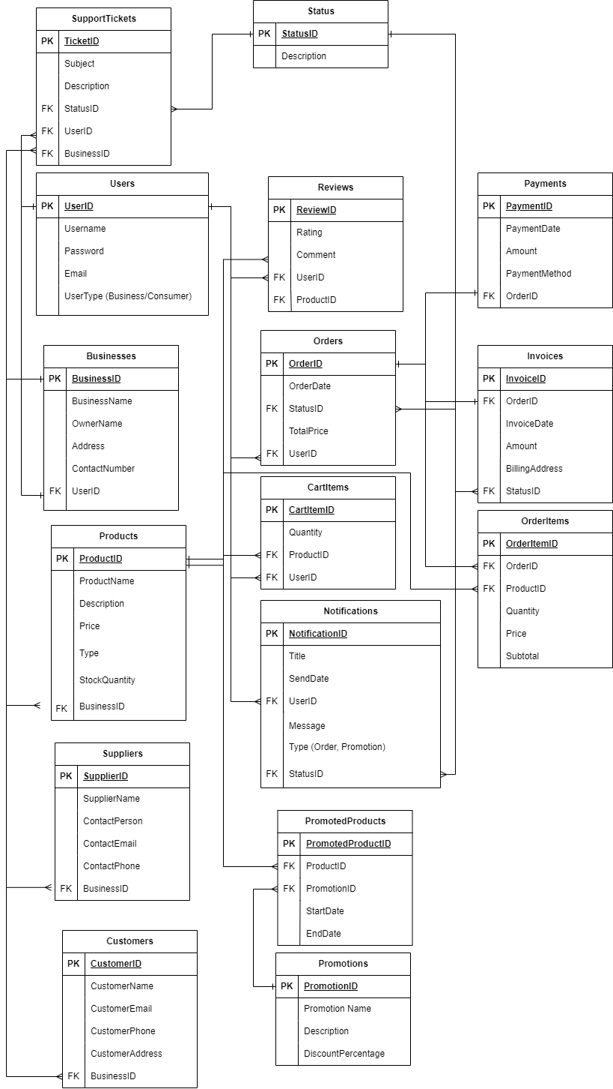
Physical Design
Note:
FK: Foreign Key
PK: Primary Key
16 Tables
Thanh Minh
Notes:
Here is the final ERD of our system platform. We also have built the database for storing the data based on this diagram. It concludes 16 tables and are linked together with the evidence from the image I am showing. This ERD shows the relationships between the different tables in our database. For example, the Orders table is linked to the Users table and the Products table. This means that each order must be placed by a user and must be for a product. I also have noted that PK means Primary Key and FK means Foreign Key. All the primary keys are listed out and they are unique identifier for each row in the table and the foreign key is a column in one table that references the primary key in another table.

Slide 8
Relationship Entities
Avoid Many-To-Many Relationship
Creating more tables for specific purposes
Examples from our databases
Users - Businesses (One-To-One)
Businesses - Products (One-To-Many)
Orders - Invoice (One-To-One)
Businesses - Suppliers (One-To-Many)
Users - Notifications (One-To-Many)
Thanh Minh
Notes:
For the relationship entities, our team has tried to avoid many-to-many relationship because they can lead to data inconsistency and errors. We have create more junction tables which contains both the primary keys of 2 entities involved in the relationship. We have improve the efficiency of queries with the suitable relationship of entities such as Users and Businesses is One - To - One relationship and other examples also are included in this slide.

Slide 9
SQL Use Cases
Transaction
Backup
Atomicity
Consistency
Isolation
Durability
Error Handling
Concurrency Control
Nhat Nam
Data Protection
Data Recovery
User Error Safeguard
Software Error Defense
Security Against Attacks and Malware
Notes:
Hi everyone. I’m Nhat Nam. Today, I'm going to talk about two of the most important SQL use cases for B2B2C e-commerce platforms: transactions and backup.
MySQL transactions and backup are two essential features for any B2B2C e-commerce platform. Transactions ensure that all changes to the database are made consistently and automically, while backup protects your data from loss or corruption. By using these features, you can ensure that your data is safe and secure, and that your customers have a seamless shopping experience.
So that, our system also uses these 2 SQL use cases.

Slide 10
Specific Major
Cyber Security
User Privilege
SQL Injection
Possible Implementation
Thanh Minh
Grant the right privilege
MD5 hash the password field
Trim the input before storing
Notes:
Our team is going to pick cyber security as specific major for enhancing our database. There are 2 common errors for database: user privilege and sql injection. But we have figured out ways to improve the security such as grant the right privilege to suitable user, md5 hash the password, trim all the input before storing in the database.

Slide 11
Summary
Quy Khang
Coomarki is seeking vendors to develop a B2B2C Ecommerce Platform System, utilizing Jira, Confluence, and MySQL for project management and documentation.
The team members did a great job on the B2B2C e-commerce platform project. They created a high quality product that met all project requirements and deadlines. They also learned a lot about technology skills.
Notes:
In short, our project is about Coomarki, a leading Ecommerce company, is seeking proposals from qualified vendors to develop a B2B2C Ecommerce Platform System. The platform will connect businesses with end consumers to facilitate the buying and selling of products and services. The project will utilize Jira and Confluence for project management and documentation, and will rely on MySQL as the database. The team members did a great job on the B2B2C e-commerce platform project. They created a high quality product that met all project requirements. They were also able to meet all project deadlines. Team members learned a lot about Jira, Confluence, Initial ERD, and MySQL during the project. They will be able to use these skills in their future jobs.

Slide 12
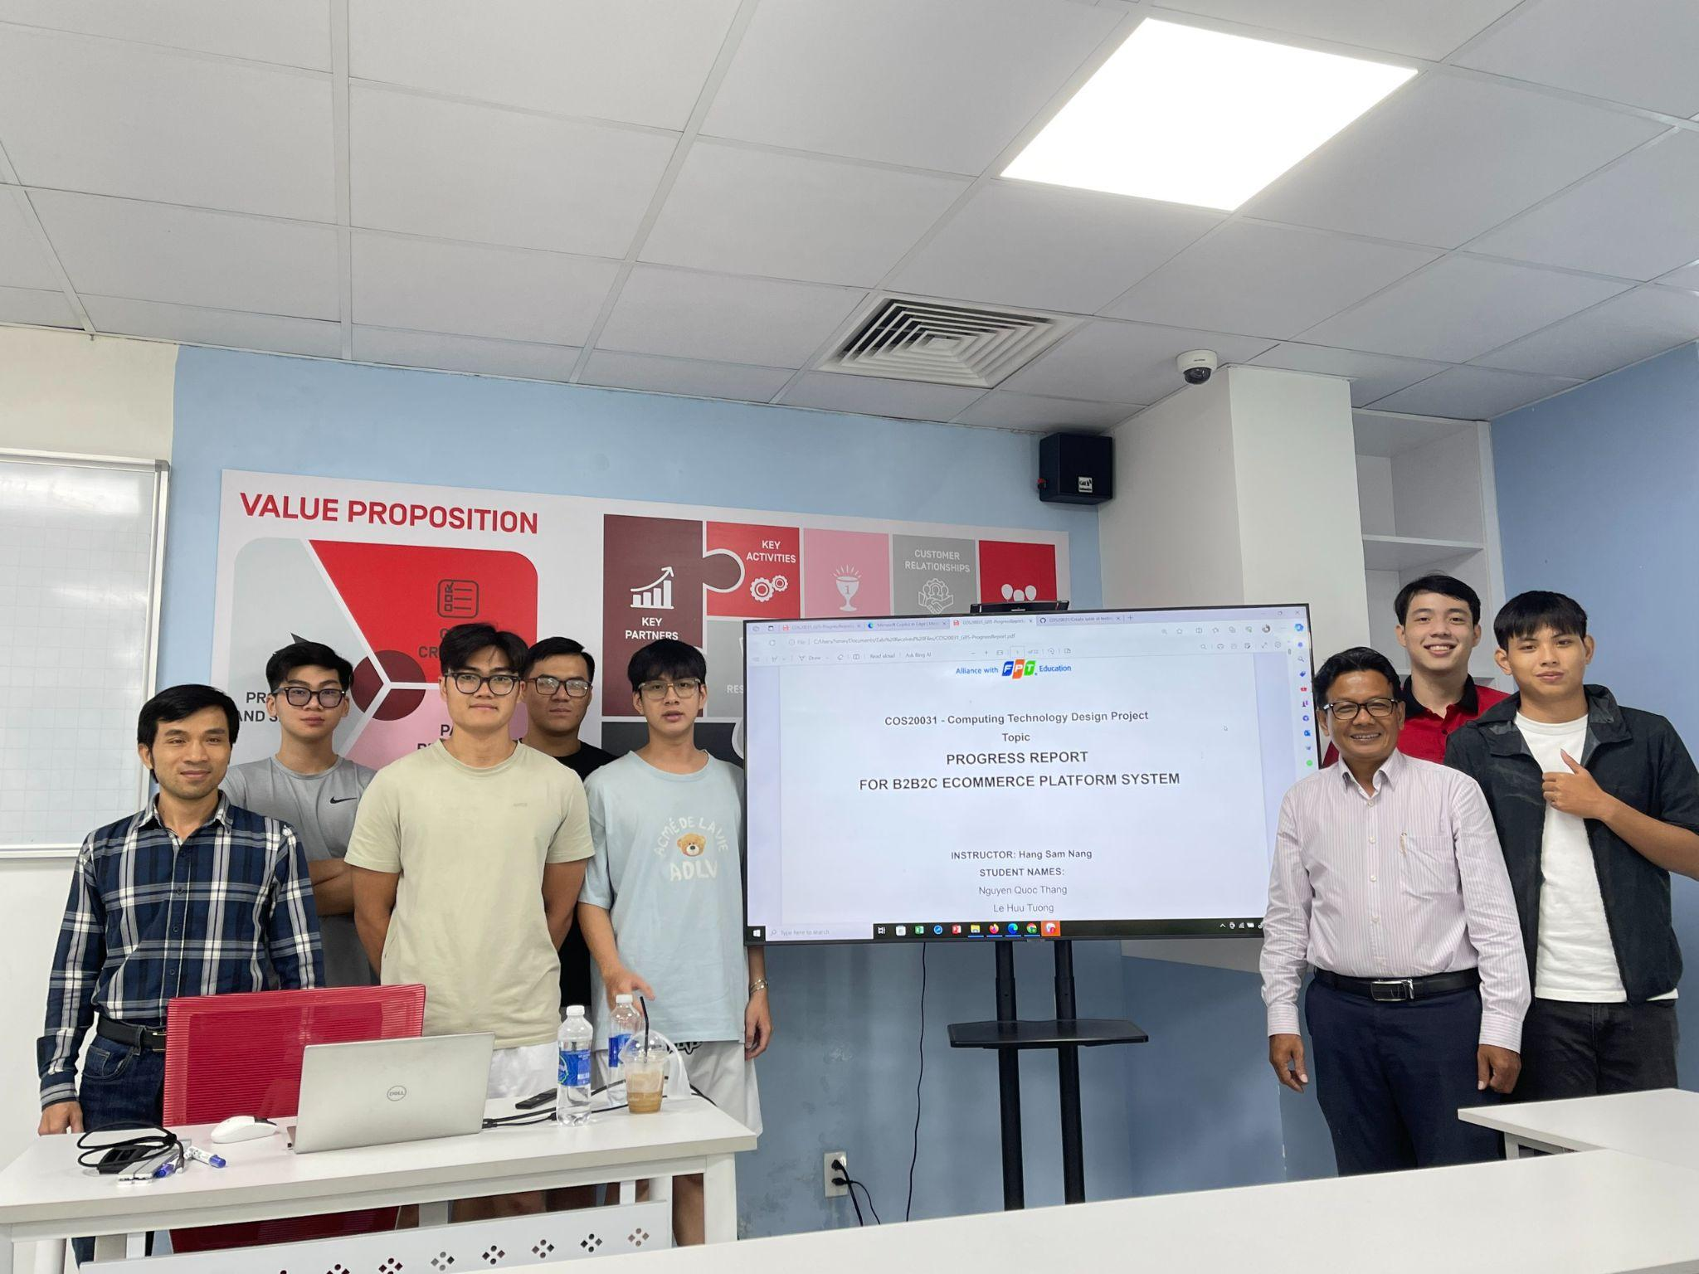
THANKS!
COS20031 - Group 5
Quy Khang
Tran Thai Duy Khang - 104225629
Trinh Quy Khang - 104212003
Le Huu Tuong - 104169756
Nguyen Quoc Thang - 104193360
Nguyen Do Nhat Nam - 104061616
Tran Thanh Minh - 103809048
Notes:
Last but not least, we have met our client and he has given a lot of advice on how to improve the infrastructure, database. Here is the photo of my team and the client and also the lecturer.Thank you for listening our presentation today. We hope that you understand the B2B2C E-Commerce Platform including how we has collaborated to make this project successful.

